Slide 1
Communication, Recap & MS Office Week commencing 01/04/2024
Unicom TIC
April 2024

Slide 2
Prerequisites
Attended the sessions of the week of Recap
Attempted to complete the related practical work
Understanding of the Learning Objectives
Identified Learning Outcomes and established whether they have been achieved

Slide 3
Learning Objectives
Understand the purpose of these sessions
Understand File Management System & Naming Conventions
Re-visit Learning Objectives

Slide 4
Purpose of Recap Sessions
Reinforce Learning
Ensure Learning Objectives have been met
Additional elements for ‘Industry Ready’ Software Engineer
Introduce relevant basic concepts
Continue to build on Communication Skills
MS Office
Sessions will very interactive !!!

Slide 5

File Management
Paths and Trees and Folders

Slide 6
Why Files?
When you use an application to do work - e.g., write a paper, make a spreadsheet, or draw a picture, the work is stored in RAM (memory) first
It is in danger of being lost if the power goes off (RAM is volatile!)
When you save it, it is copied to a secondary storage device like the hard drive or a flash drive
It is saved as a FILE with a name, extension, time, date, size
The extension, if there is one, is at the right end of the name, with a period before it, like file1.abc

Slide 7
File Names and Extensions
You must adhere to file-naming conventions when saving files
Case sensitivity – upper and lower case are different
True in Linux and Unix variations, not in Windows
If “ABC” and “abc” are different names, it IS case sensitive
Maximum length ???
Spaces allowed – be careful if using multiple spaces, can you see the difference between 2 spaces and three spaces?
Digits allowed
\ / : * ? " < > | not allowed
File extensions provide clues to the file contents
OS uses extensions to know which application created the file and the internal format of the file

Slide 8
Standard Filename Extensions
Extension | Type of Document | Application
.doc or .docx | Word processing document | Microsoft Word
.xls or .xlsx | Workbook | Microsoft Excel
.ppt or .pptx | PowerPoint presentation | MS PowerPoint
.accdb | Database | Microsoft Access
.gif, .jpg, .png | Images | Windows Image Viewer
.mp4, .mp3 | Videos, audio | Windows Media
.zip | Compressed file | WinZip
.pdf | Portable Document Format | Adobe Acrobat
.htm or .html | Web page | Hypertext Markup Language

Slide 9
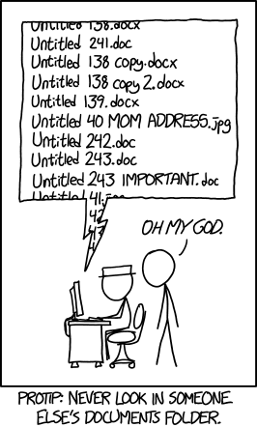
What are file naming conventions?
A file naming convention is a framework for naming your files in a way that describes what they contain and how they relate to other files.
File naming conventions help you stay organized and quickly identify your files. In a shared or collaborative group file-sharing setting, it will help others more easily navigate your work.
It is essential to establish a convention before you begin collecting files or data in order to prevent a backlog of unorganized content that will lead to misplaced or lost data!

Slide 10
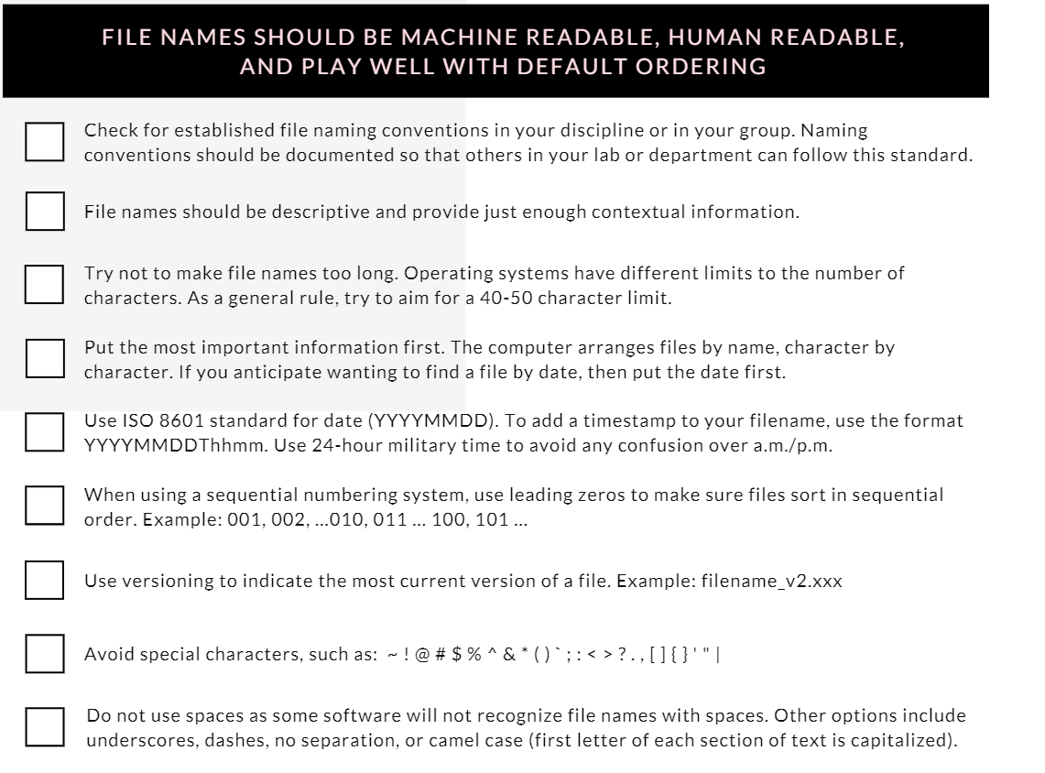

Slide 12
File Systems – Drives
Every computer has a file system used to keep track of the files on that machine
File systems are based on physical storage devices, known as drives
Drives can be local or remote (network or cloud)
Click on “My Computer” or “This PC” to see a list of drives (on a Windows machine)

Slide 13
File Systems – Drives
Typical Drives
A: or B: → Floppy Disk
C: → Local Hard Drive
D: → CD Drive
E-Z for removable drives like memory sticks
About any letter can be used for a partition of a device

Slide 14
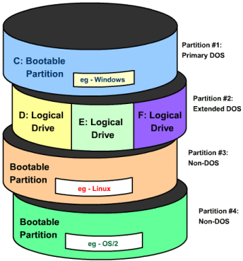
Sample Disk Partition

Slide 15
File Management
The operating system provides an organizational structure to the computer’s data and programs
Hierarchical structure of directories:
Drives
Folders
and more Folders …
Files
Storage metaphors help you visualize and mentally organize the files on your disks and other storage devices
Notes:
An additional function of the OS is to enable file management, which entails providing organizational structure to the computer’s contents. The OS allows you to organize the contents of your computer in a hierarchical structure of directories that includes drives, folders, subfolders, and files.
.

Slide 16
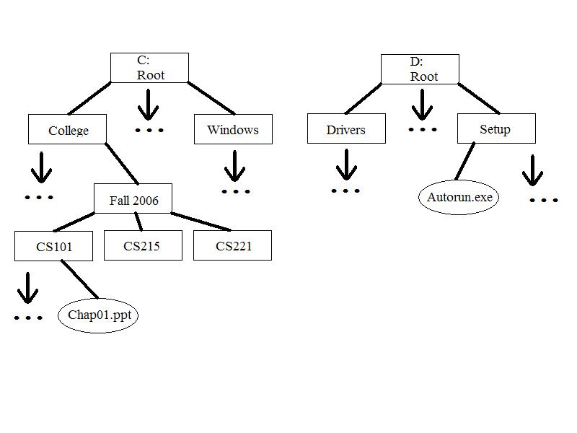
A File System Tree (2 devices)

Slide 17
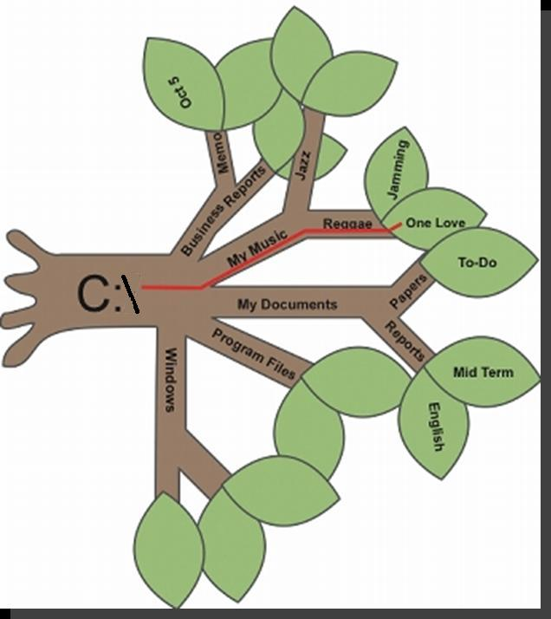
File Management Metaphors
Tree Metaphor
Root, branches, leaves
Filing Cabinet Metaphor
Drawers, Folders, Files

Slide 18
File Directories and Folders
Every storage device has a directory containing a list of its files
Root directory (like “C:\”)
Subdirectory
Depicted as folders
A computer’s file location is defined by a path
Examples: D:\ is the root of the D drive
Examples: C:\Notes\CS 101\Week 1\notes.txt
Examples: F:\1999\Music\CDs\Prince\

Slide 19
Where is my Desktop??
The Desktop Is really just another folder!
On Windows, it is at C:\Users\yourusername\Desktop\
On MacOS, it is /Users/yourusername/Desktop/

Slide 20
File Formats
A file format refers to the organization and layout of data that is stored in a file
A file extension usually indicates the format of a file and the application which was used to create the file
But it does not have to! Just changing the extension on a file from xlsx to zip does not make the file a zip file! It needs to be converted from a spreadsheet to a zipped file using the zip application.

Slide 21
Applications and Files
Most applications that create files have a file menu
Choices will include Save and Save As
Save saves using same filename, if has been saved once already
Save asks for new name if it has not been saved before
Save As asks for new name and saves new copy of file
Rename – allows you to change the name of the current file

Slide 22
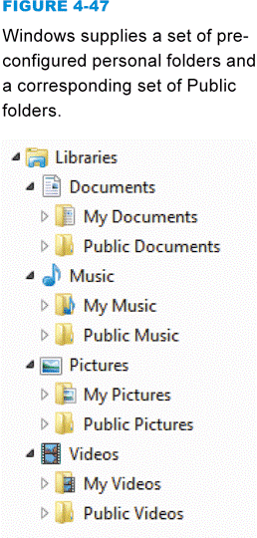
File Explorer
File Explorer (also known as Windows Explorer) helps you manipulate files and folders in the following ways:
Rename
Copy
Move
Delete
Windows offers a set of preconfigured personal folders, such as My Documents and My Music, for storing your personal data files. You can make subdirectories in these too!

Slide 23
Windows Explorer
NOT the same as Internet Explorer! Windows Explorer is a file manager
Shows files in different views
Shows files’ information: name, date modified, type, size and others you can set (Turn menu bar on, then View then menu choice Choose Details)
Uses Graphical User Interface to let you move files around, copy them, erase them

Slide 24
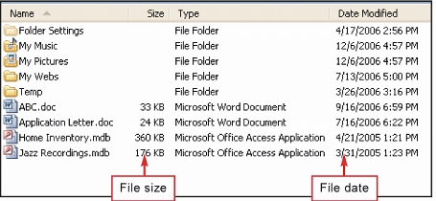
File Sizes and Dates
A file contains data, stored as a group of bits
File size is usually measured in bytes, kilobytes, or megabytes
The file date indicates the date that a file was created or last modified

Slide 25
File Sizes and Dates
Why is the file size important?
Memory and Storage Capacity
“How many songs can I fit on my MP3 player?”
“How many pictures can I take with my camera?”
"Did all my data get saved?“
“Did I submit a file for the lab test that was empty?”
Why is the file date important?
History of File Creation and Last Modification
“Which one is the latest version of my paper?”
“Did I submit my lab test on time?”

Slide 26
File Management Tips
Use descriptive names
Maintain file extensions – don’t change one unless you convert the file to that type
Group similar files into a folder
Organize your folders from the top down
Consider using default folders but consider putting folders inside them – My Documents can be subdivided as you like!
Do not mix data files and program files in the same folder

Slide 27
File Management Tips
Don’t store too many files in the root directory – actually slows down the access
Follow copyright rules
Delete or archive files you no longer need
Be aware of storage locations!
You will not be able to submit your lab test work if you do not know where you put your files!
Make Backups!

Slide 28
Shortcuts
Can create another icon which points to a file or folder or program
Double clicking on it is equivalent to double clicking on what it points to
But be careful! The shortcut is NOT a copy of the file! If the original file is moved or deleted, the shortcut does not work
When submitting lab tests, be careful of this! Do not send your TA JUST a bunch of shortcuts!

Slide 29
Introduction to Web Development & Web Hosting 6th April 2024

Slide 30
What are the 3 Types of Software
System software
Programming software
Application software
Anything Else ?
Firmware

Slide 31
Steps in the software development process (11)
Selecting a methodology
Gathering requirements
Choosing or building an architecture
Developing a design
Building a model
Constructing code
Testing
Managing configuration and defects
Deploying
Migrating data
Managing and measuring the project
Notes:
Selecting a methodology to establish a framework in which the steps of software development are applied. It describes an overall work process or roadmap for the project. Methodologies can include Agile development, DevOps, Rapid Application Development (RAD), Scaled Agile Framework (SAFe), Waterfall, and others.
Gathering requirements to understand and document what is required by users and other stakeholders.
Choosing or building an architecture as the underlying structure within which the software will operate.
Developing a design around solutions to the problems presented by requirements, often involving process models and storyboards.
Building a model with a modeling tool that uses a modeling language like SysML or UML to conduct early validation, prototyping, and simulation of the design.
Constructing code in the appropriate programming language. Involves peer and team review to eliminate problems early and produce quality software faster.
Testing with pre-planned scenarios as part of software design and coding — and conducting performance testing to simulate load testing on the application.
Managing configuration and defects to understand all the software artifacts (requirements, design, code, test) and build distinct versions of the software. Establish quality assurance priorities and release criteria to address and track defects.
Deploying the software for use and responding to and resolving user problems.
Migrating data to the new or updated software from existing applications or data sources if necessary.
Managing and measuring the project to maintain quality and delivery over the application lifecycle, and to evaluate the development process with models such as the Capability Maturity Model (CMM)

Slide 32
How long will each of these steps take ? (%)
Selecting a methodology
Gathering requirements
Choosing or building an architecture
Developing a design
Building a model
Constructing code
Testing
Managing configuration and defects
Deploying
Migrating data
Managing and measuring the project

Slide 33
Development
Front End
Back End
Development Tools – IDE ? VCS?

Slide 34
Best Practices
Responsive Design
Performance Optimization
Accessibility
Security
Notes:
Web Content Accessibility Guidelines

Slide 35
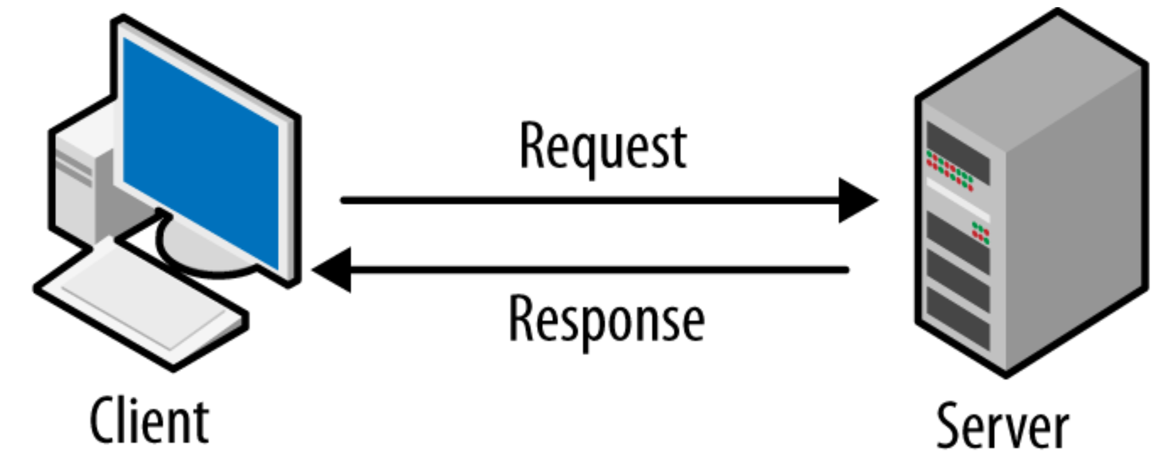
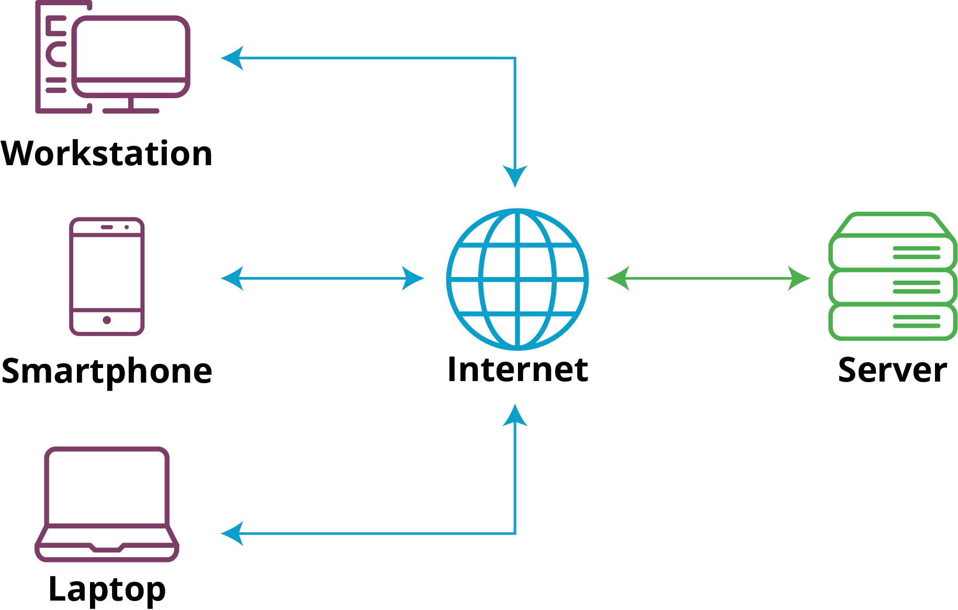
Client-Server Architecture
Notes:
Client: A client is typically a web browser (like Chrome, Firefox, Safari) or a mobile app that requests resources or services from a server.
Server: A server is a remote computer or system that stores data, processes requests, and delivers resources or services to clients.

Slide 36
What are the 3 major components of client-server architecture?
Presentation
Application logic
Data storage.

Slide 37

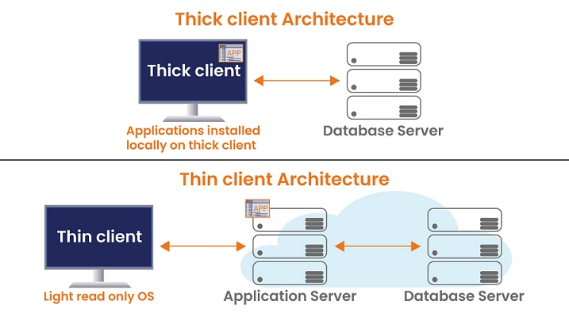
Thin client vs Thick Client

Slide 38
Some Jargon ☺
HTTP
DNS
URL
Request – Response Cyle
Hosting

Slide 39
HTML & CSS 7th April 2024

Slide 40
Elements, Tags and Attributes ?
Elements – What to display
Attributes – How they behave
Tags – Beginning (and) End of Elements

Slide 41
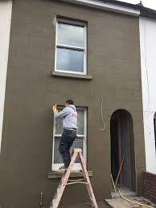
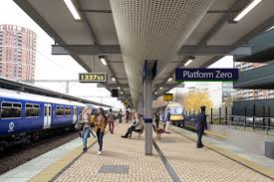

Some more Jargon ☺
Hypertext
Rendering
1. a performance of a piece of music or drama.
"a lively rendering of ‘Ilkley Moor’"
2. the action of applying plaster to a wall.
"the walls are capped and ready for rendering“
Libraries
Platform Independent

Slide 42
CSS
What is it ?
Do we need it in HTML ?

Slide 43
Faster Page Speed
More code means slower page speed. And CSS enables you to use less code. CSS allows you to use one CSS rule and apply it to all occurrences of a certain tag within an HTML document.
Better User Experience
CSS not only makes web pages easy on the eye, it also allows for user-friendly formatting. When buttons and text are in logical places and well organized, user experience improves.
Quicker Development Time
With CSS, you can apply specific formatting rules and styles to multiple pages with one string of code. One cascading style sheet can be replicated across several website pages. If, for instance, you have product pages that should all have the same formatting, look, and feel, writing CSS rules for one page will suffice for all pages of that same type.
Easy Formatting Changes
If you need to change the format of a specific set of pages, it’s easy to do so with CSS. There’s no need to fix every individual page. Just edit the corresponding CSS stylesheet and you’ll see changes applied to all the pages that are using that style sheet.
Compatibility Across Devices
Responsive web design matters. In today’s day and age, web pages must be fully visible and easily navigable on all devices. Whether mobile or tablet, desktop, or even smart TV, CSS combines with HTML to make responsive design possible.

Slide 44
3 ways to include CSS
Inline - by using the style attribute inside HTML elements.
Internal - by using a <style> element in the <head> section.
External - by using a <link> element to link to an external CSS file.

Slide 45
Feature | Inline CSS | Internal CSS | External CSS
Location | It is used within HTML tag using the style attribute. | It is used within <head> section of HTML document. | It is used in a separate .css file.
Selector Scope | Affects a single element or a group of elements. | Affects multiple elements within the same HTML element. | Affects multiple HTML documents or an entire website.
Reusability | Not reusable. Styles need to be repeated for each element. | Can be reused on multiple elements within the same HTML document. | Can be reused on multiple HTML documents or an entire website.
Priority | Highest priority. Overrides internal and external styles. | Medium priority. Overrides external styles but can be overridden by inline styles. | Lowest priority. Can be overridden by both inline and internal styles.
File Size | Inline styles increase the HTML file size, which can affect the page load time. | Internal styles are part of the HTML file, which increases the file size. | External styles are in a separate file, which reduces the HTML file size and can be cached for faster page loads.
Maintainability | Not easy to maintain. Changes need to be made manually to each element. | Relatively easy to maintain. Changes need to be made in one place in the <head> section. | Easiest to maintain. Changes need to be made in one place in the external .css file.

Slide 46
CSS Selectors
CSS selectors are used to define the elements you want to style with CSS. There are many different types of CSS selectors, each with their own unique syntax. These tell the browser which elements to apply CSS property values to.
Class Selector
ID Selector
Element Selector
Universal Selector ??

Slide 47
Class & ID
The “id” attribute is employed to uniquely identify a specific element on a page.
The “class” attribute is utilised to categorize and apply styles or scripts to multiple elements, enabling the application of common styles to various parts of the page where the class is assigned.

Slide 48
Any Questions?

Slide 49
SBAR

Slide 50
Situation :- சூழ்நிலை
Background :- பின்னணி
Assessment :- மதிப்பீடு
Recommendation:- பரிந்துரை

Slide 51
Let's have a go !!

